Slide 1
Web Direct- Azure.cn (New UI)
1RMB Sign-up Process (Desktop Version)
September, 2016

Slide 2
1RMB Trial- Happy Path for Individual

Slide 3
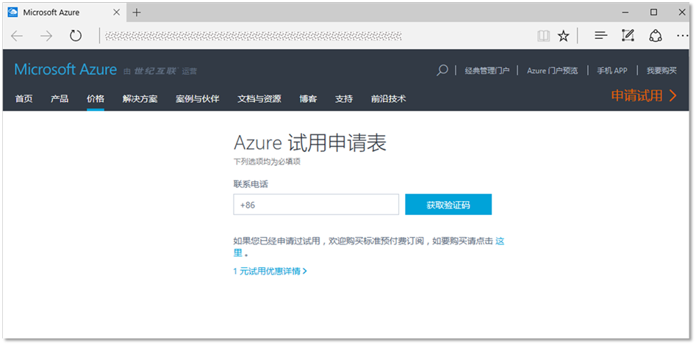
1RMB Trial Application Page

Slide 4
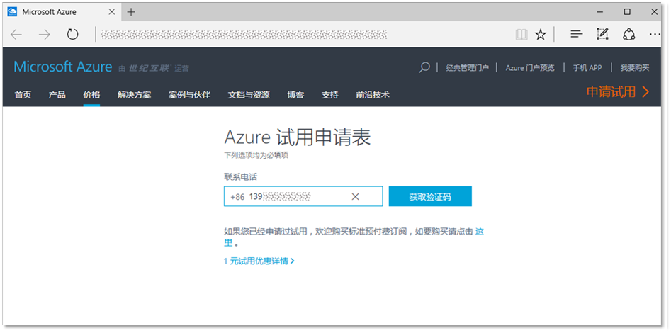
Enter Mobile phone number

Slide 5
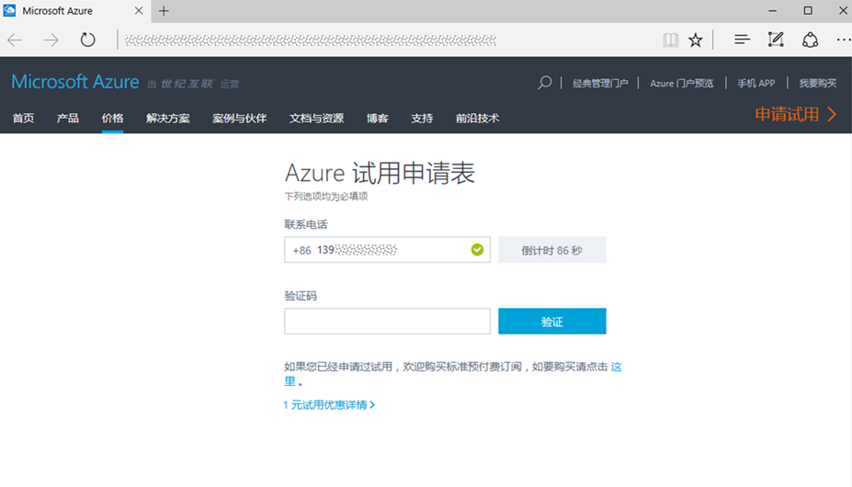
Get SMS Verification Code

Slide 6
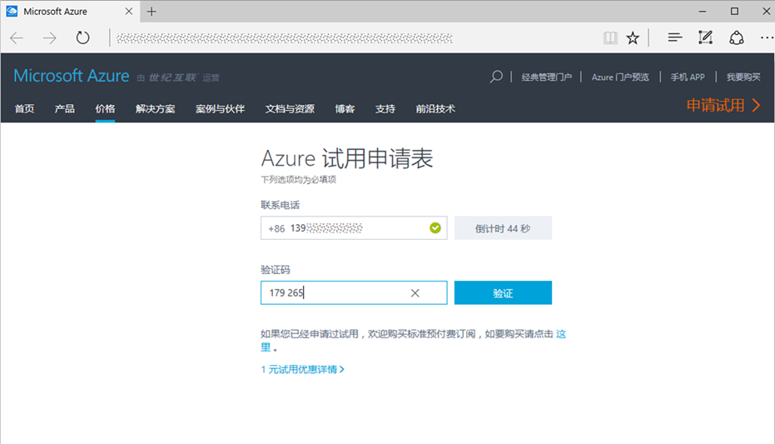
Verify SMS Verification Code

Slide 7
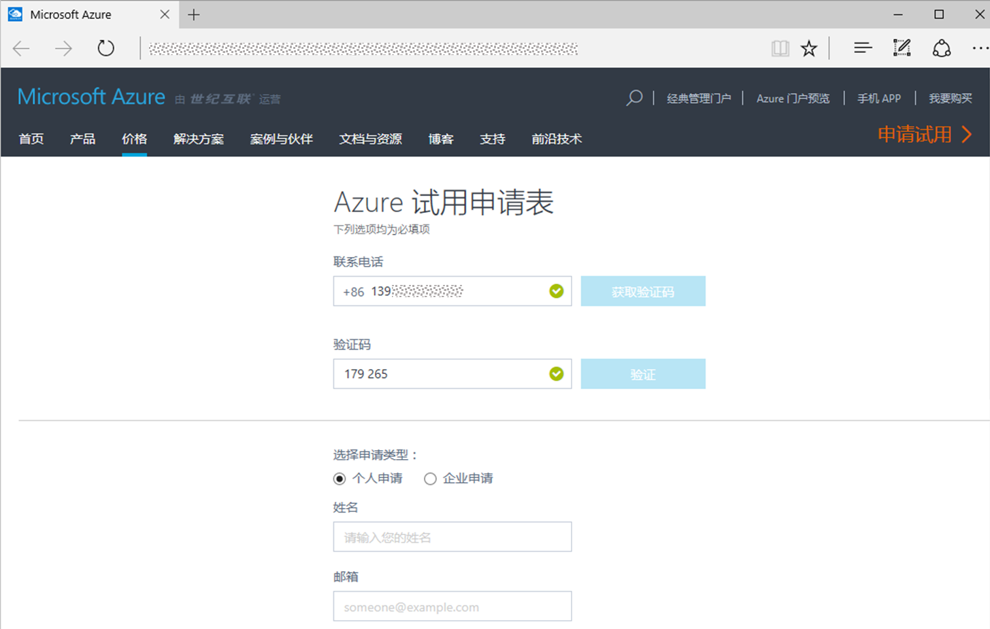
Select Real Name Authentication Type – Individual or Enterprise

Slide 8
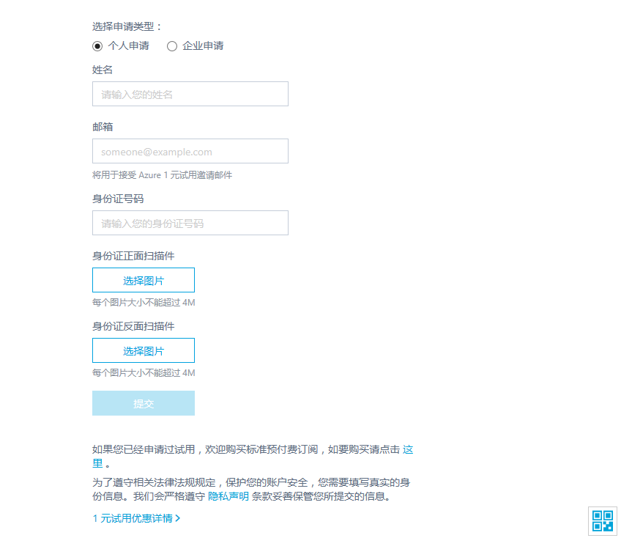
Real Name Authentication Form - Individual

Slide 9
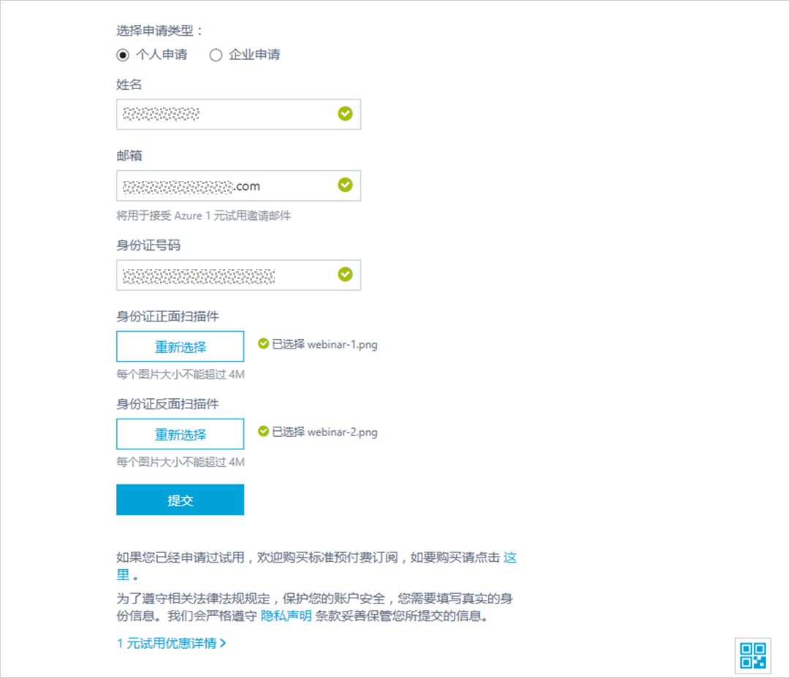
Input/Submit Individual Real Name Authentication Data

Slide 10
1RMB Trial- Happy Path for Real Name Check Passed Individual, directly sign-up at Account Portal; meanwhile receive a notification email with promo code.

Slide 11
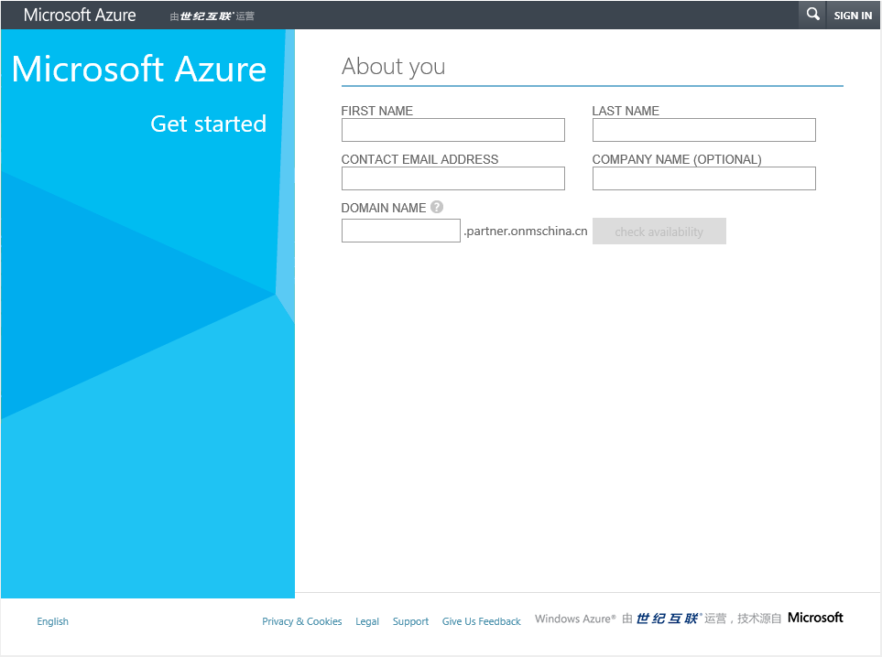
Account Portal for Creating Account and Subscription

Slide 12
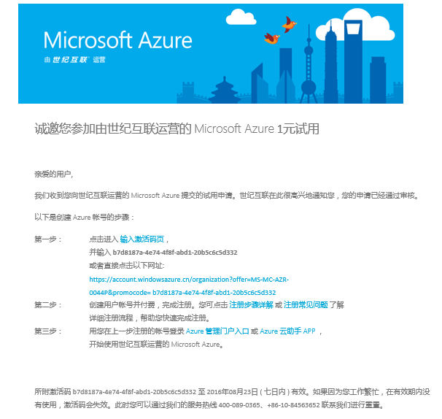
Notification Email with Sign-up Promo Code Link for Real Name Check Passed Customer

Slide 13
1RMB Trial- Form for Enterprise

Slide 14
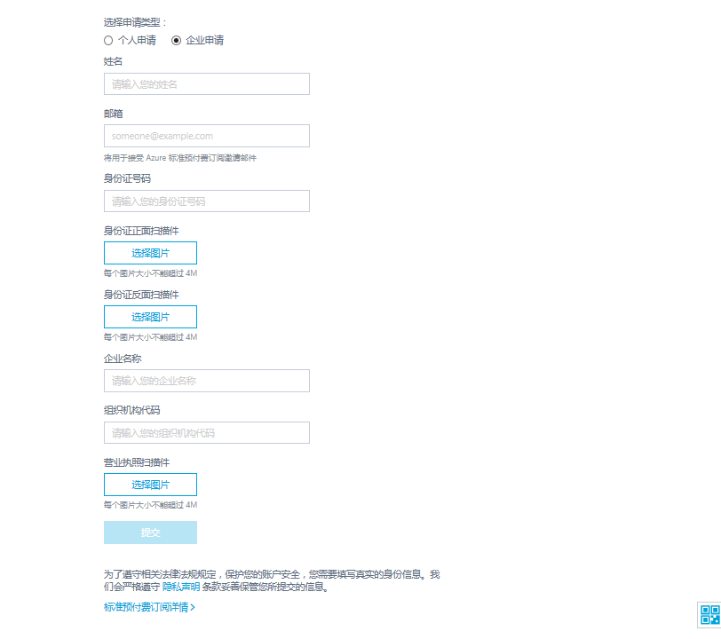
[OR] 1RMB Trial- Real Name Authentication Form - Enterprise

Slide 15
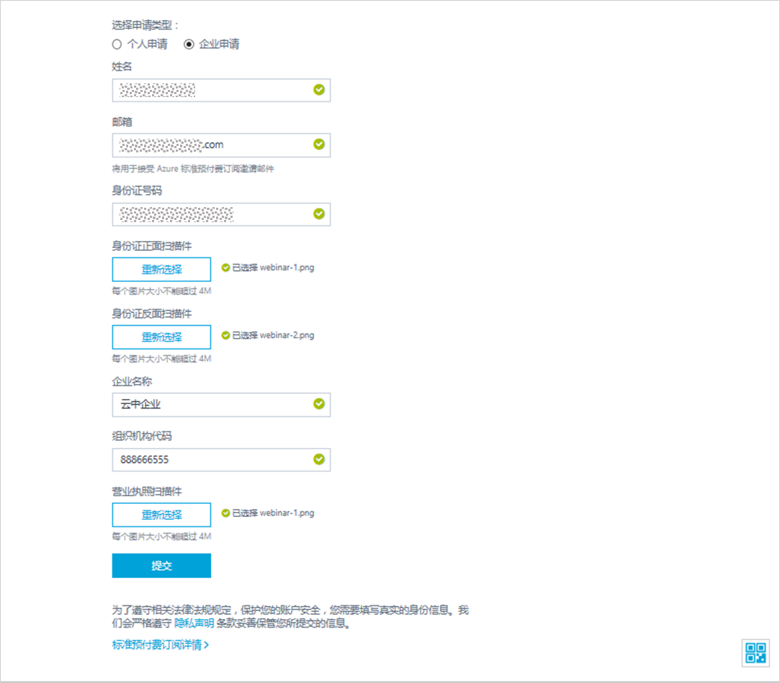
1RMB Trial -Input Enterprise Real Name Authentication Data

Slide 16
1RMB Trial- Real Name Check Risk Rule & Error Handling

Slide 17
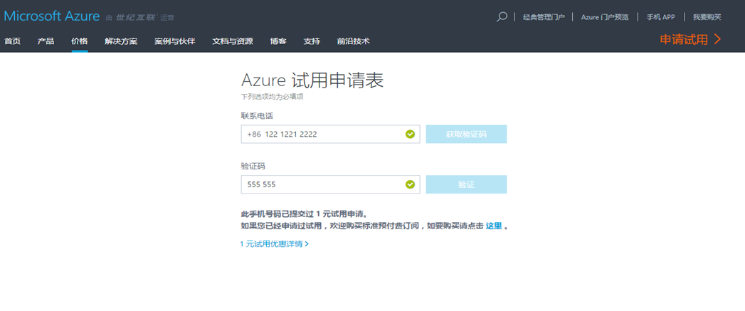
Risk Rule (Phone)- 1RMB Trial One ID + One Phone can only apply once

Slide 18
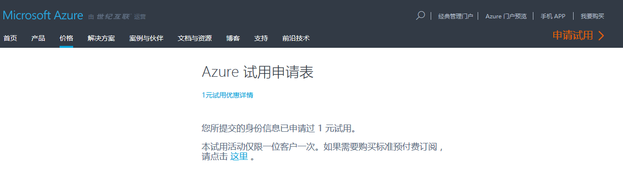
Risk Rule (ID)- 1RMB Trial One ID + One Phone can only apply once

Slide 19
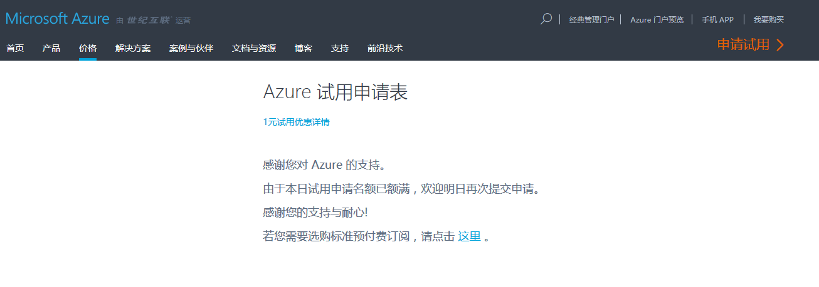
Risk Rule- 1RMB Submit Daily Limit Message

Slide 20
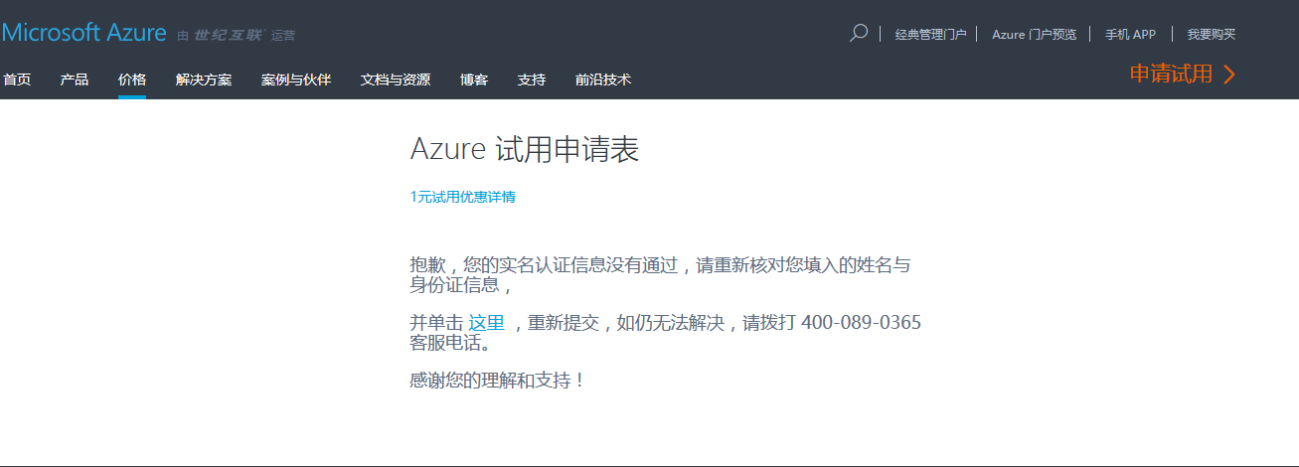
Real Name Check Failed Error Page-

Slide 21
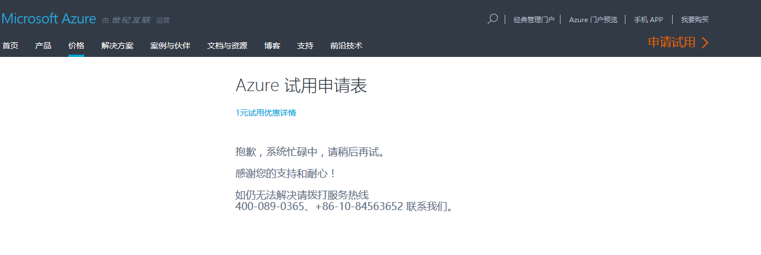
Error Message for NCIIC API or 21V Web Service Issue/ Outage

Slide 22
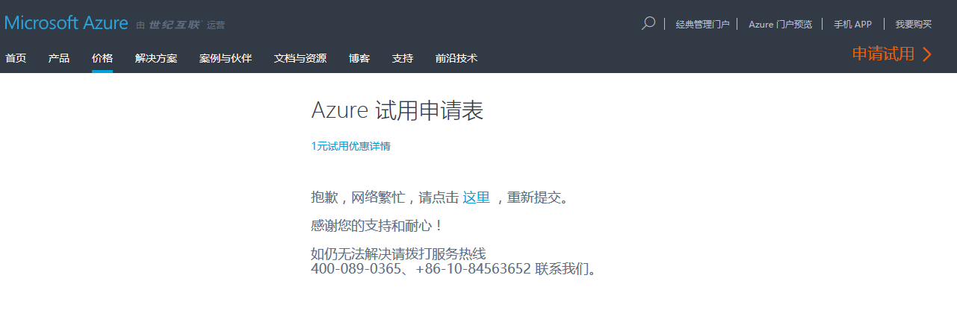
Error Message for 1RMB Submit Network Issue

Slide 23
1RMB Sign-up Process (Mobile Version)

Slide 24
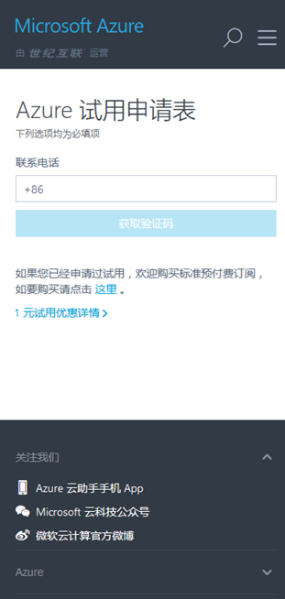
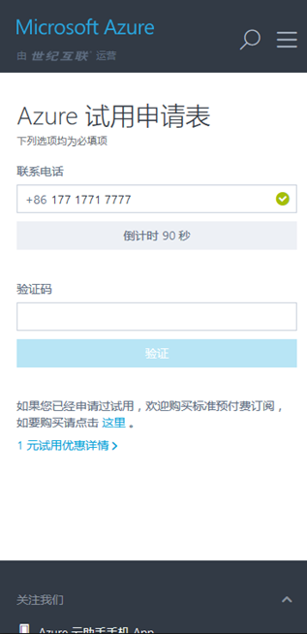
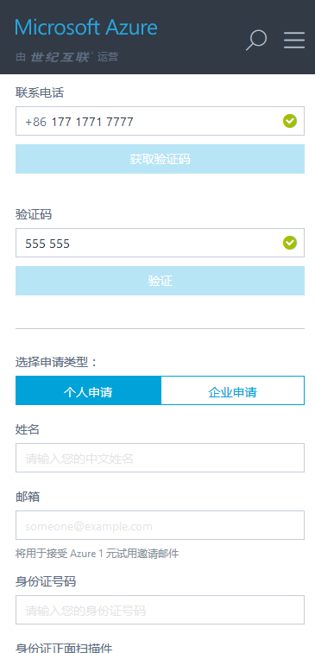
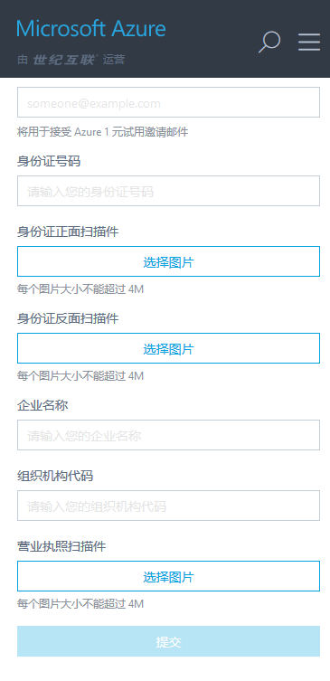
1RMB Trail Real Name Authentication – Mobile Sample Pages

